Slide 1
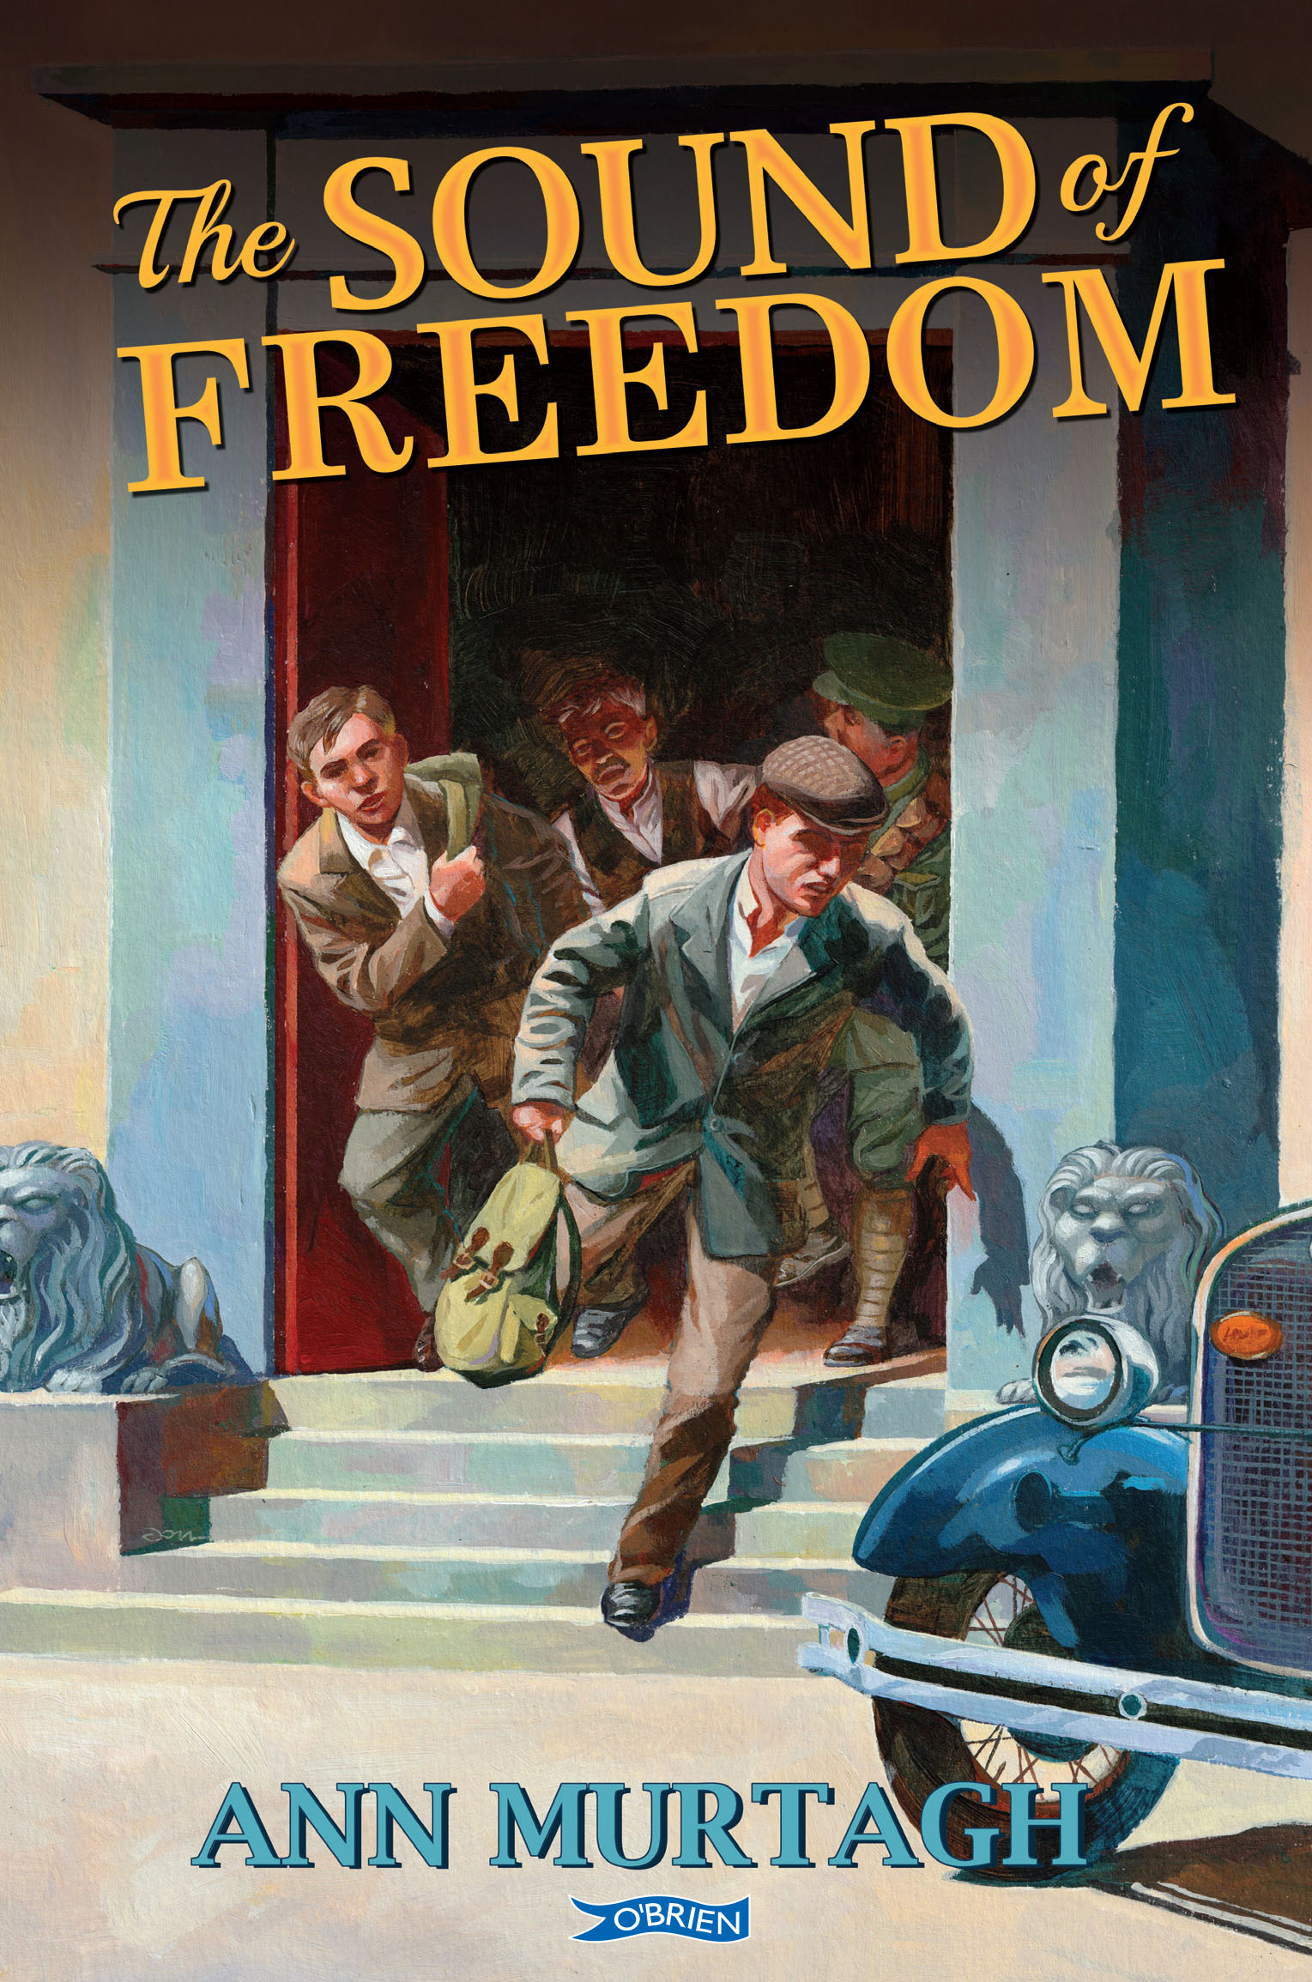
Exploring Sources for The Sound of Freedom
Library Workshop
“Supported by the Department of Tourism, Culture, Arts, Gaeltacht, Sport and Media under the Decade of Centenaries 2012-2023 initiative.”

Slide 2
Decade of Commemorations
1913
1914
1915
1916
1917
1918
1919
1920
1921
1922
1923
PARTICULARLY THESE YEARS

Slide 3
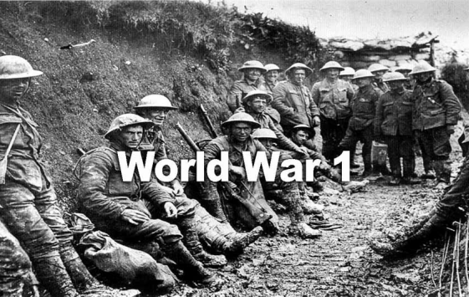
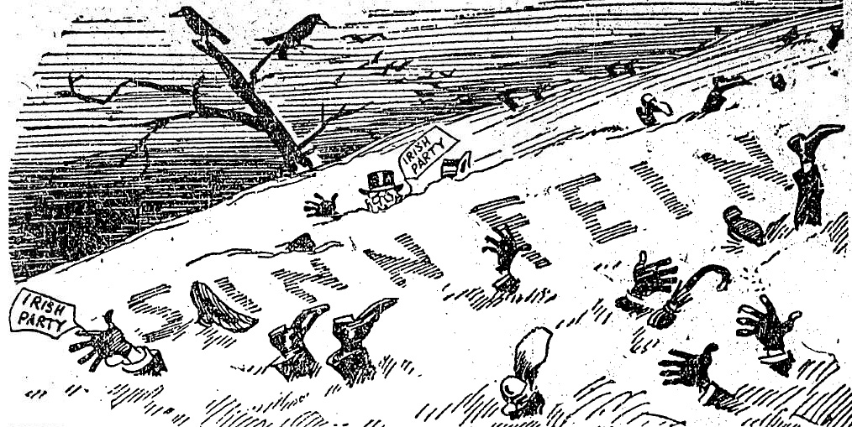
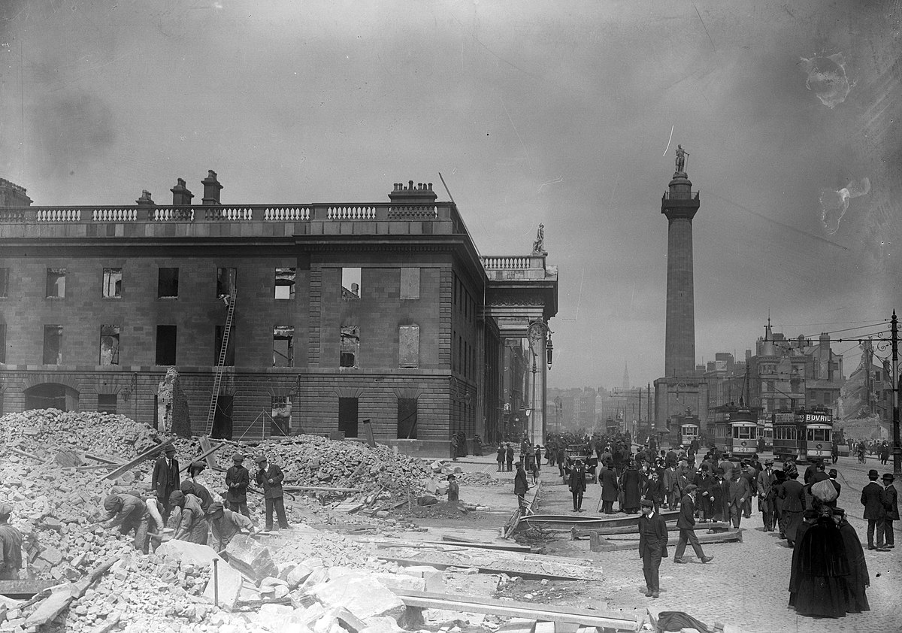
1916 Rising
1918 Election

Slide 4
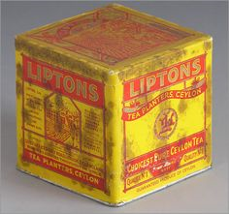
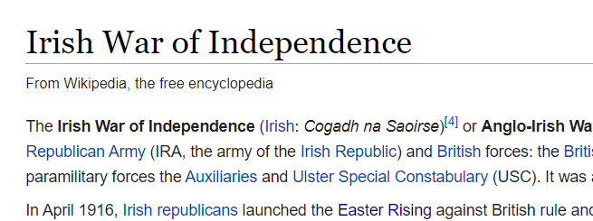
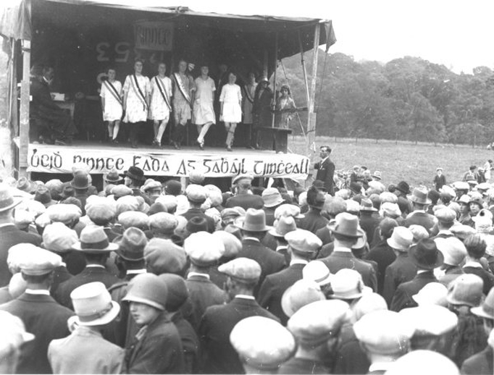
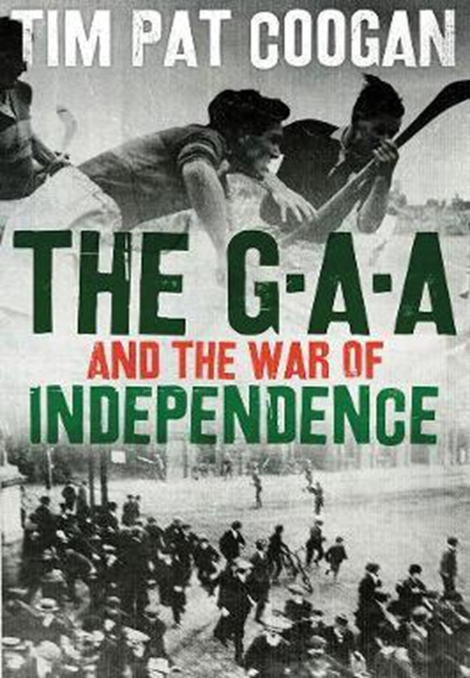
Sources
Primary and Secondary

Slide 5
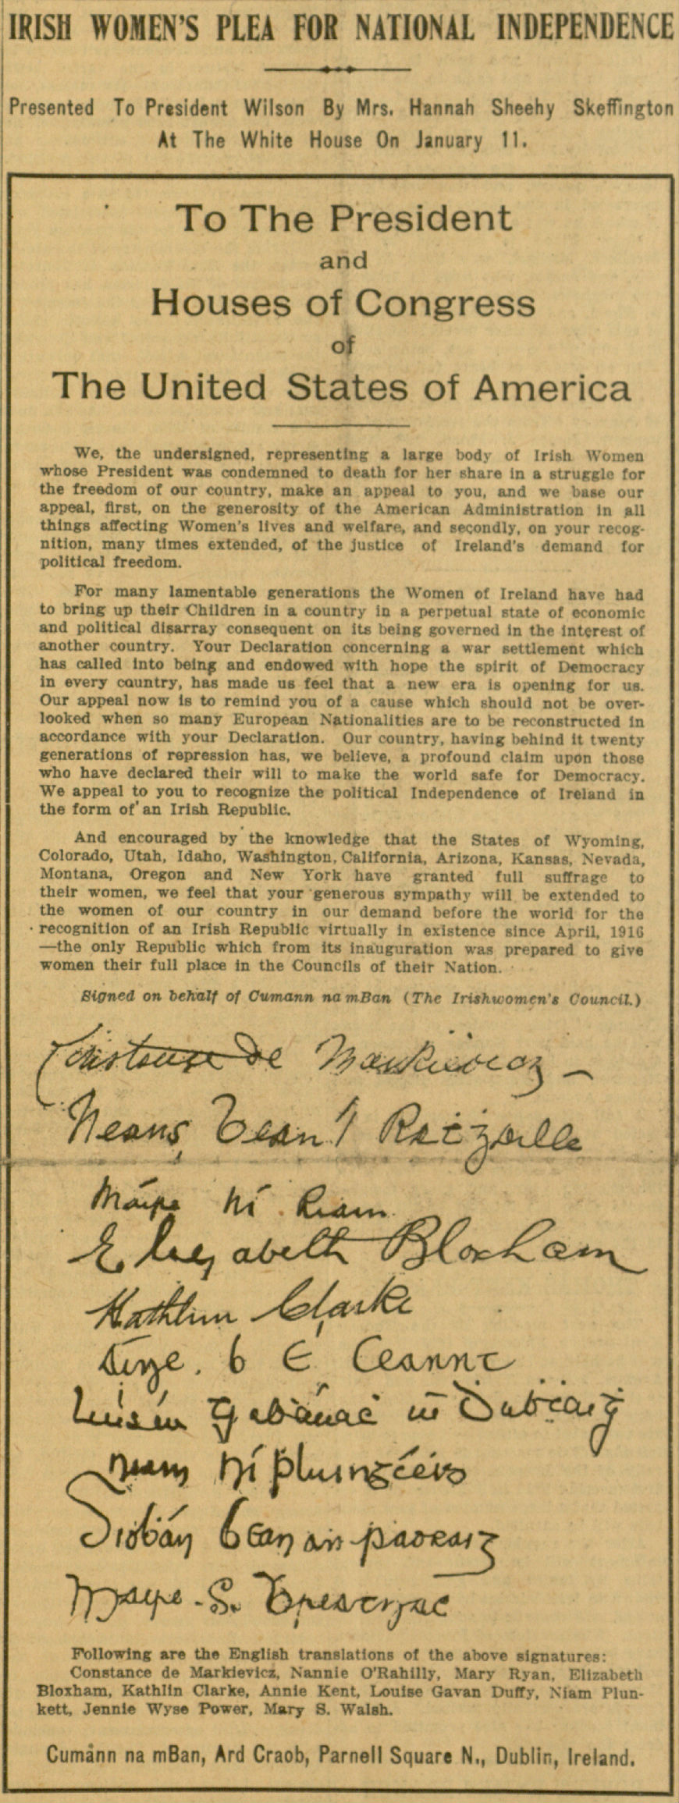
Primary Sources
I was there. I saw what happened and wrote it down.
Hanna Sheehy Skeffington

Slide 6
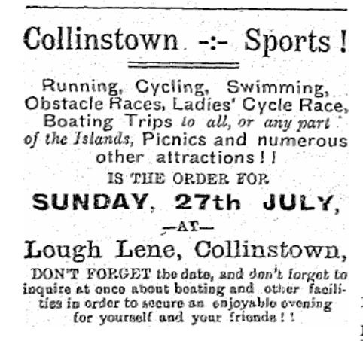
Primary Sources

Slide 7
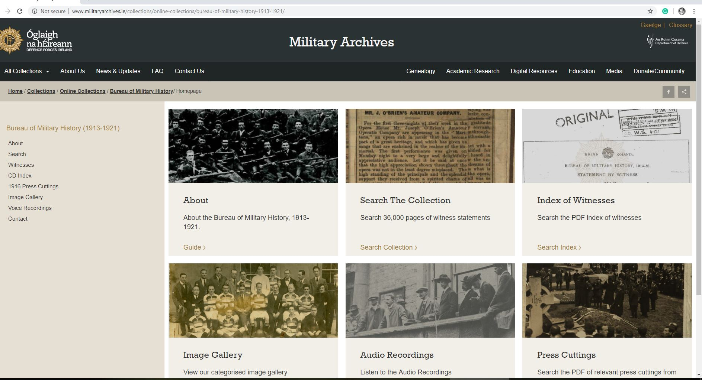
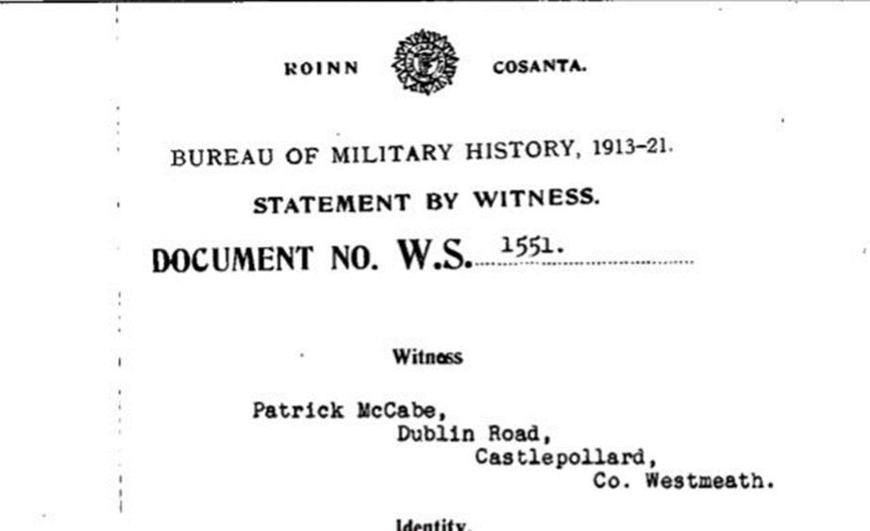
Witness Statements

Slide 8
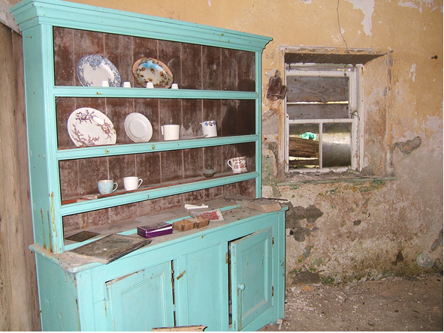
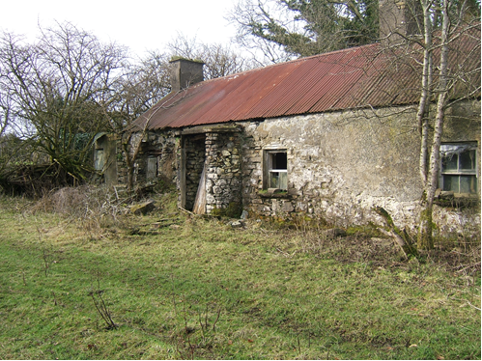
Visit to old house in Glenidan, Co Westmeath

Slide 9
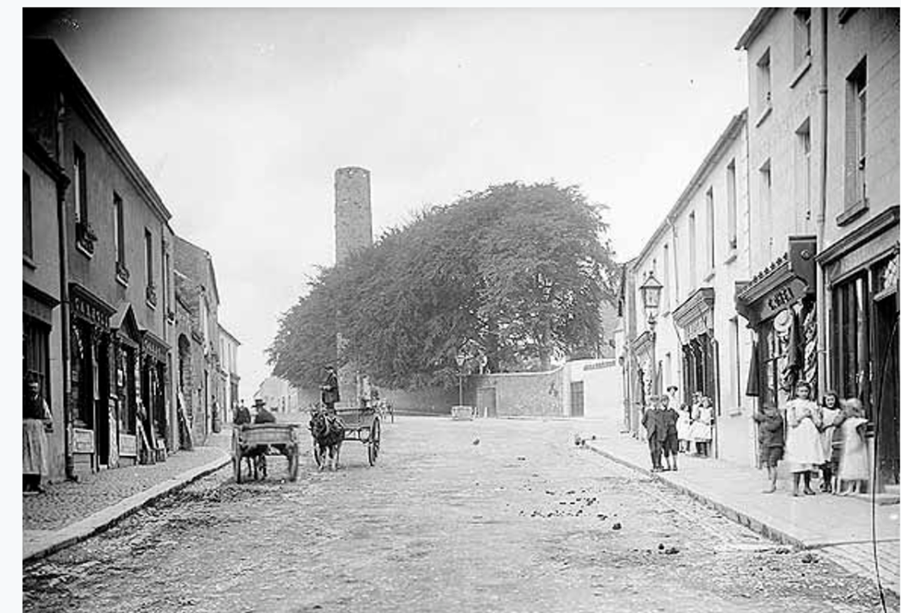
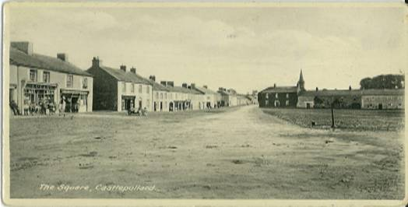
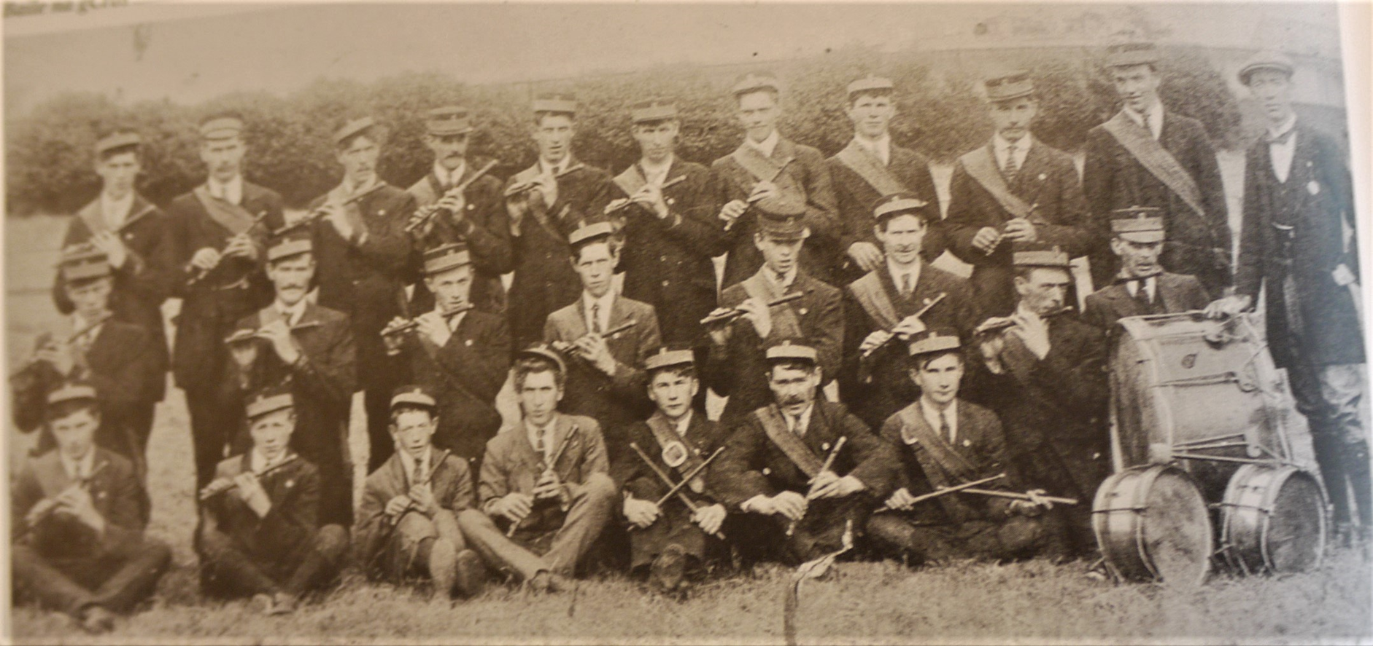
Newmarket St,
Kells, Co. Meath
The Square, Castlepollard, Co Westmeath
Glenidan Fife and Drum Band

Slide 10
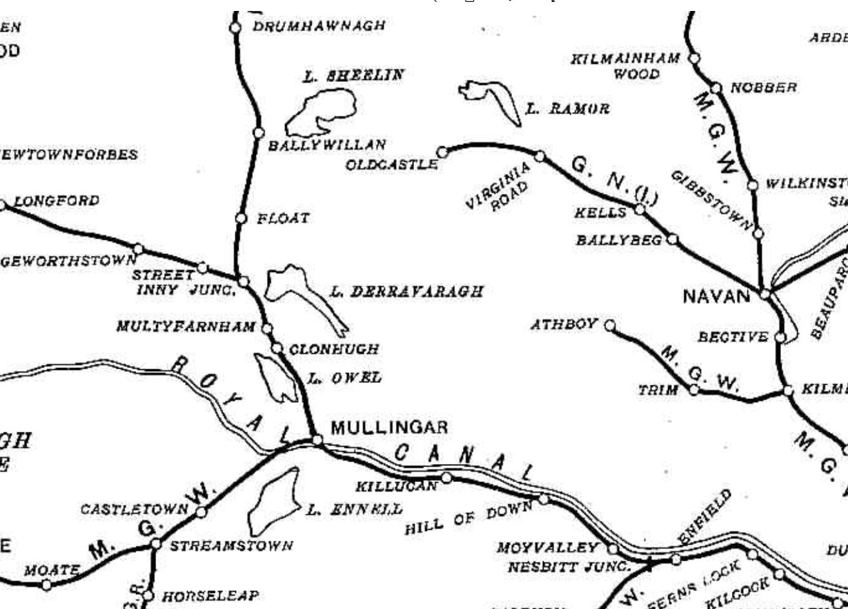

Slide 11
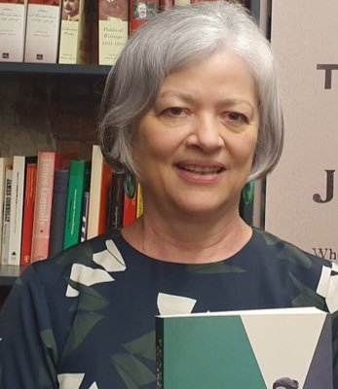
Secondary Sources
Published in 2019
I was interested in what this woman did and wrote a book about her.
Margaret Ward, Historian

Slide 12
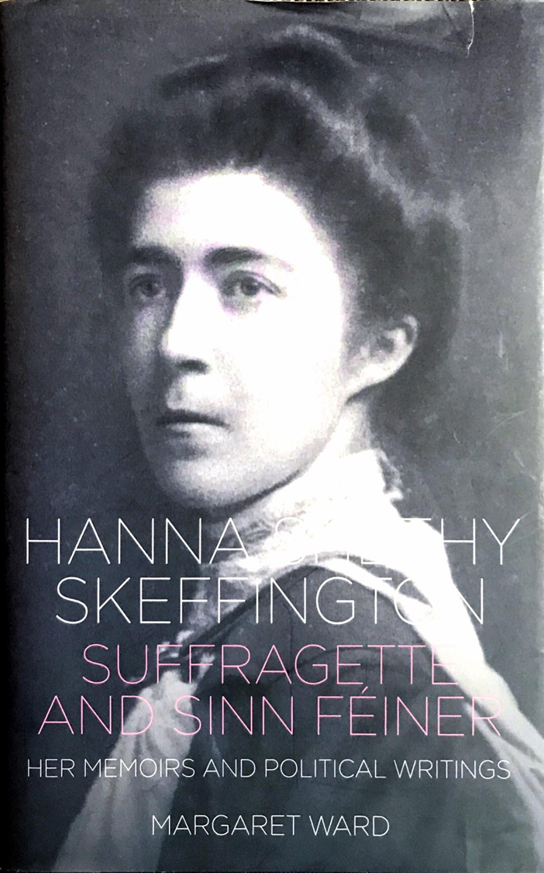
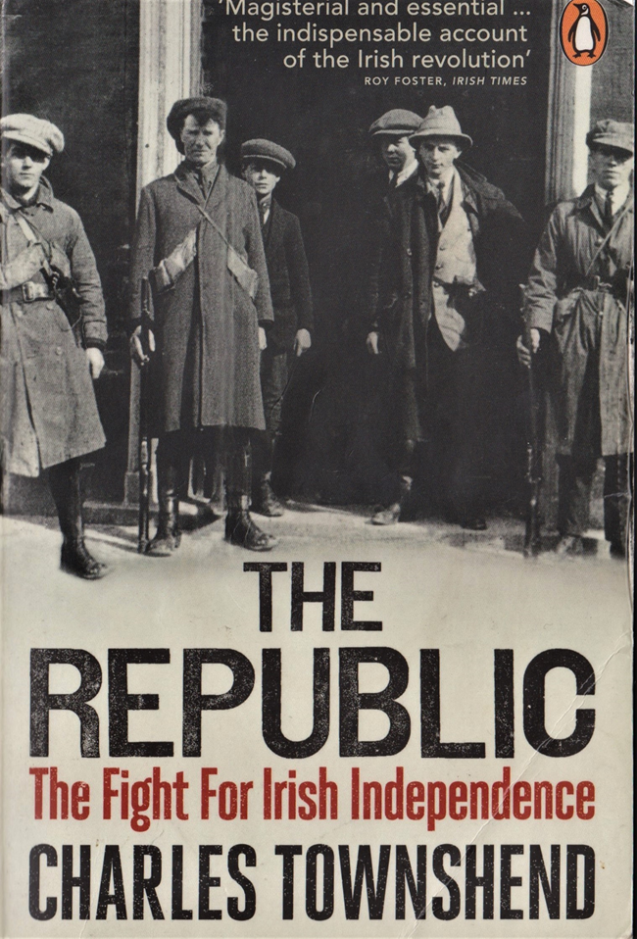
Secondary Sources

Slide 15
PRIMARY
SECONDARY

Slide 16
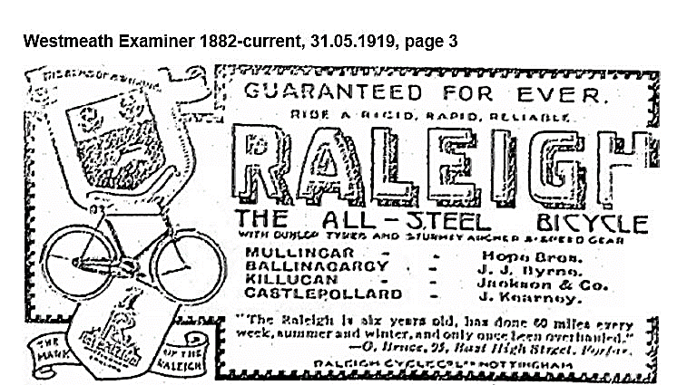

Slide 17
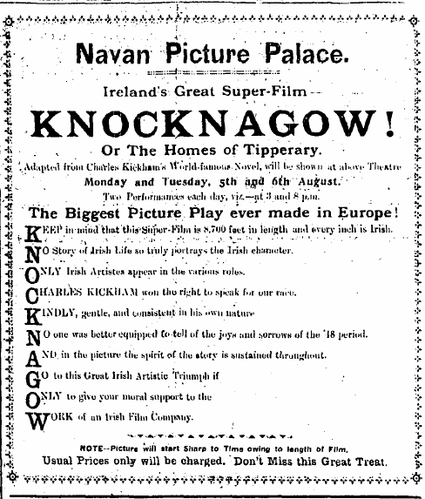
1918

Slide 18
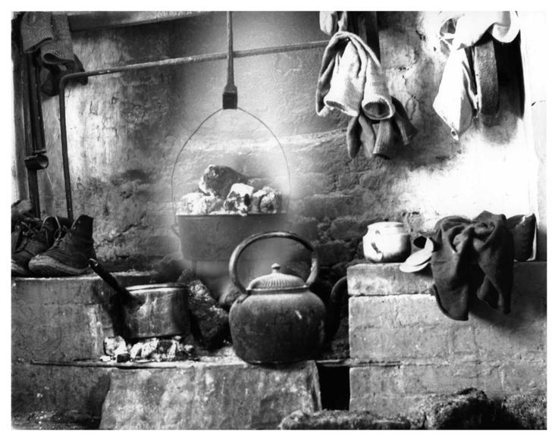

Slide 19
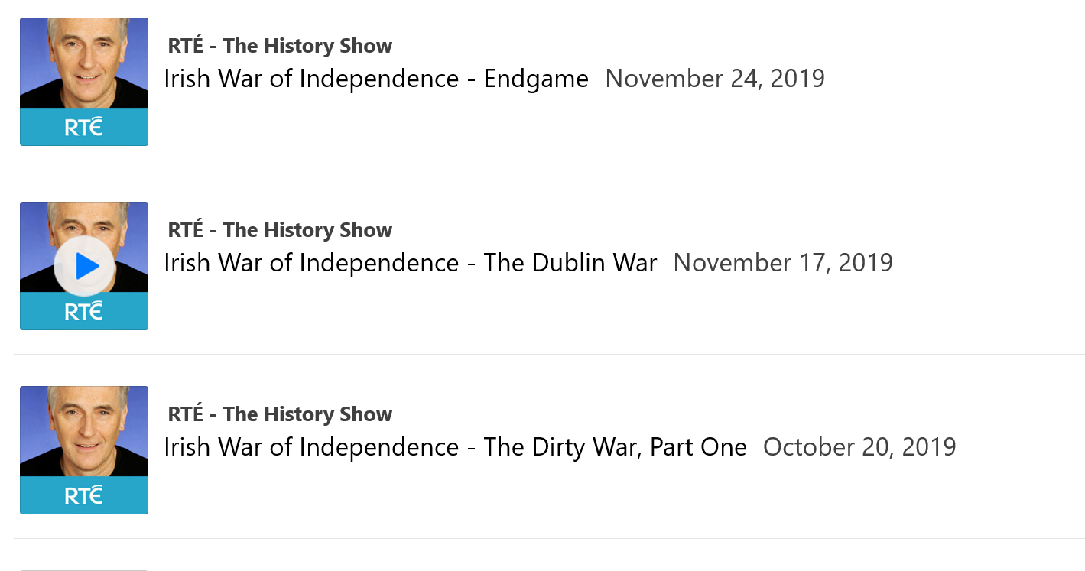

Slide 20
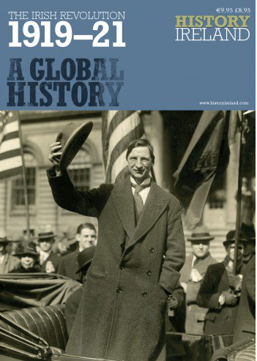
History Ireland Magazine

Slide 21
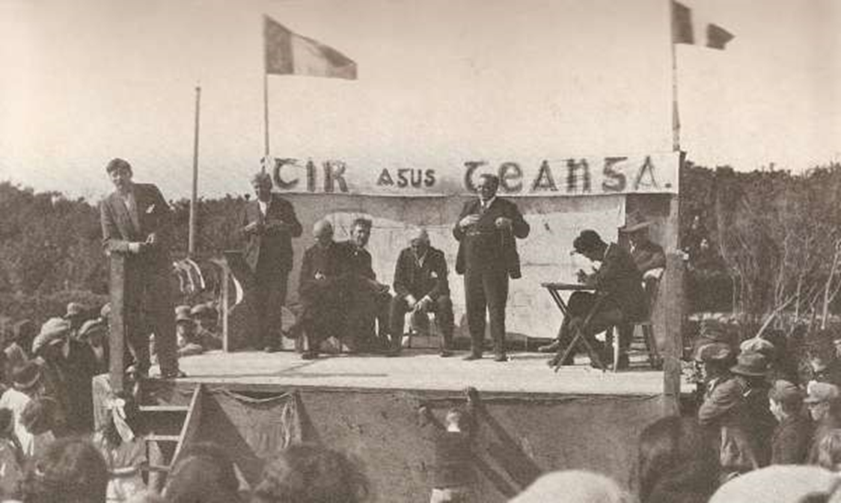

Slide 22
Optional Second Activity
Secondary Sources
Primary Sources

Slide 23
BIAS
What do you think the word bias means?

Slide 24
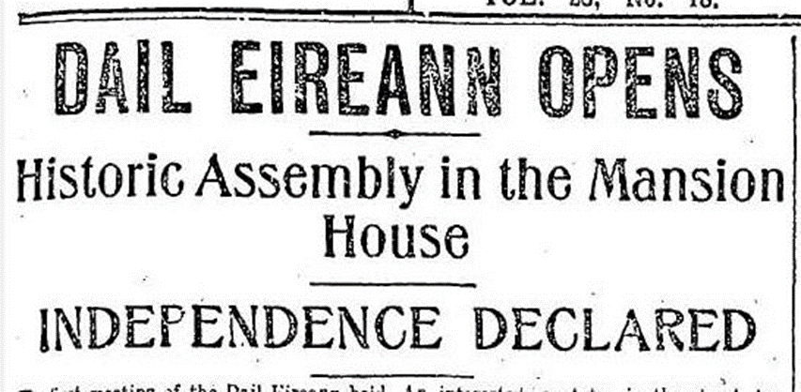
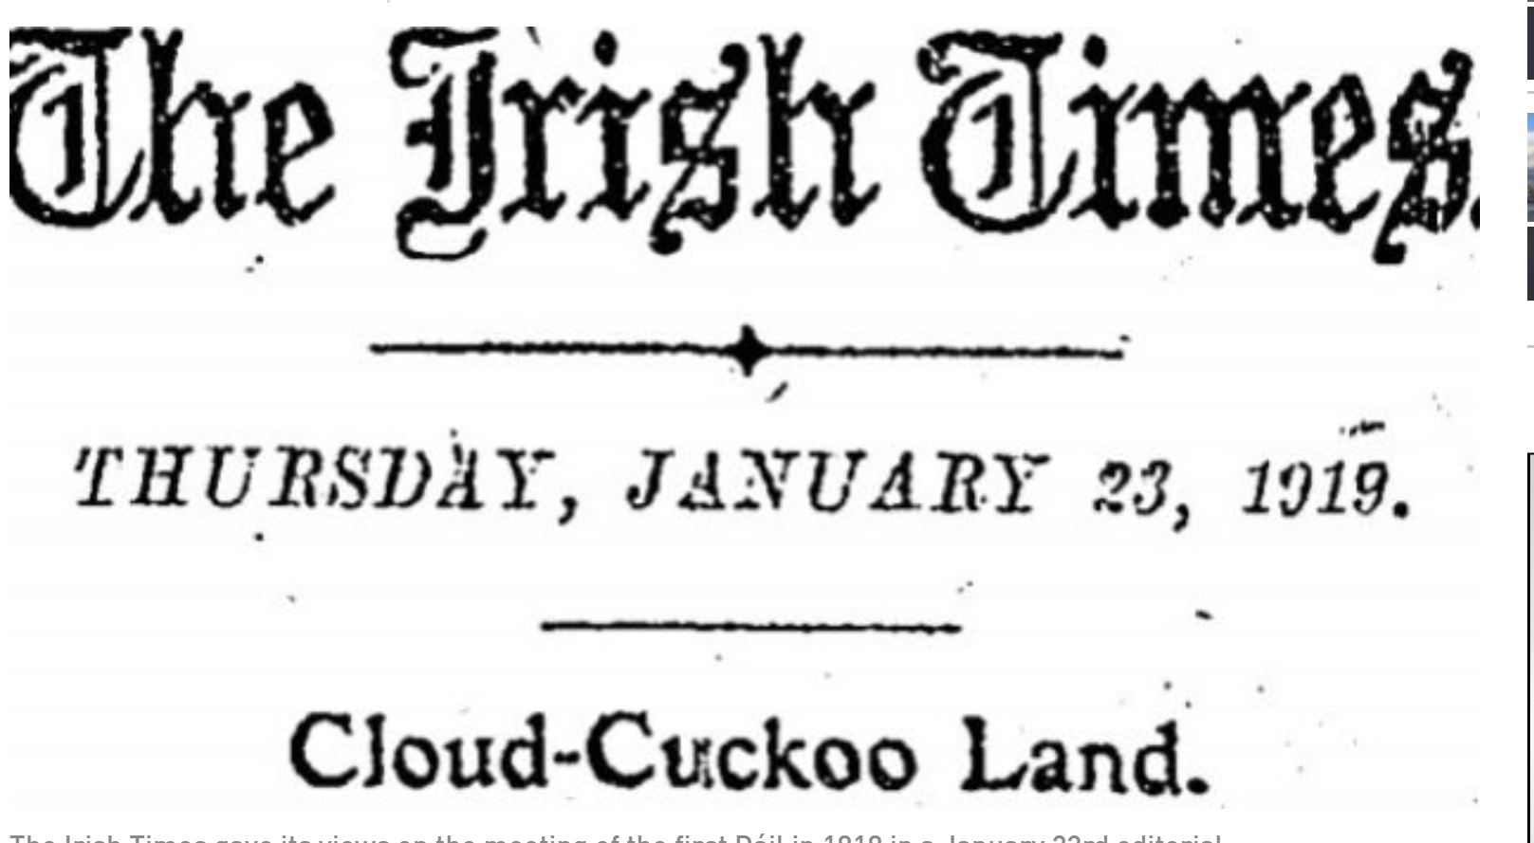
Evening Herald

Slide 25
Setting for the Story
Why do you think it was important for me to research the area where my story took place?

Slide 26
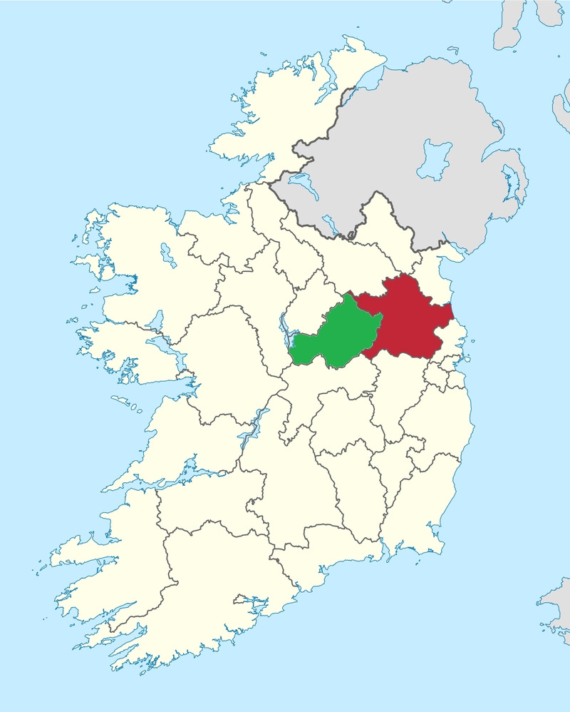
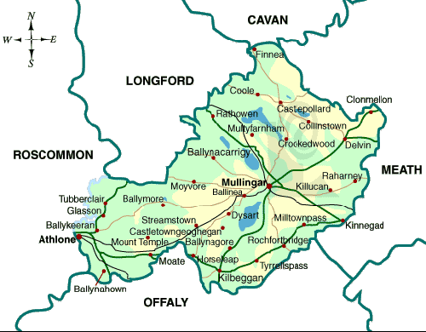

Slide 27
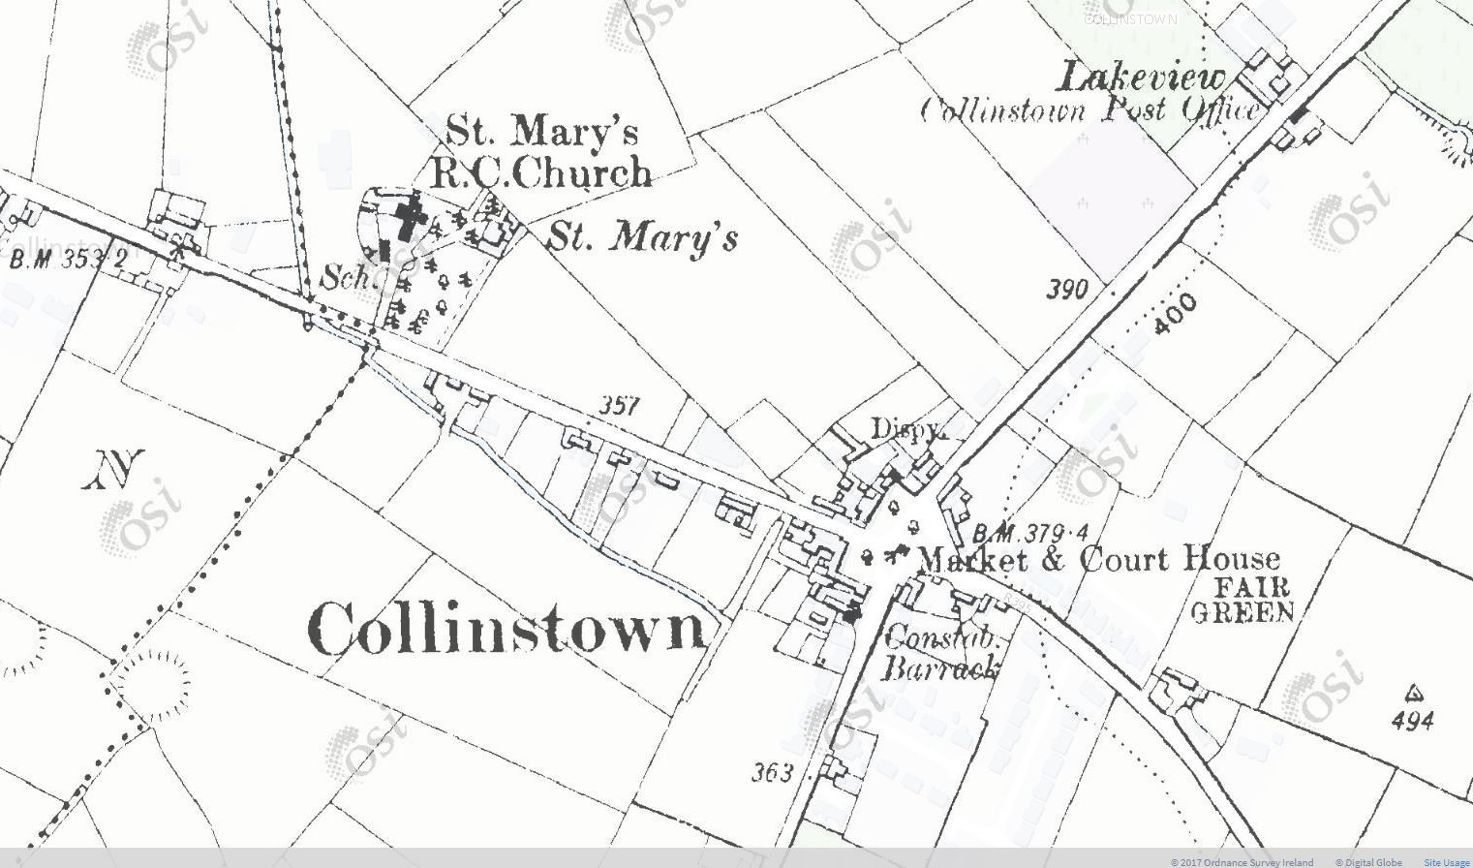

Slide 28
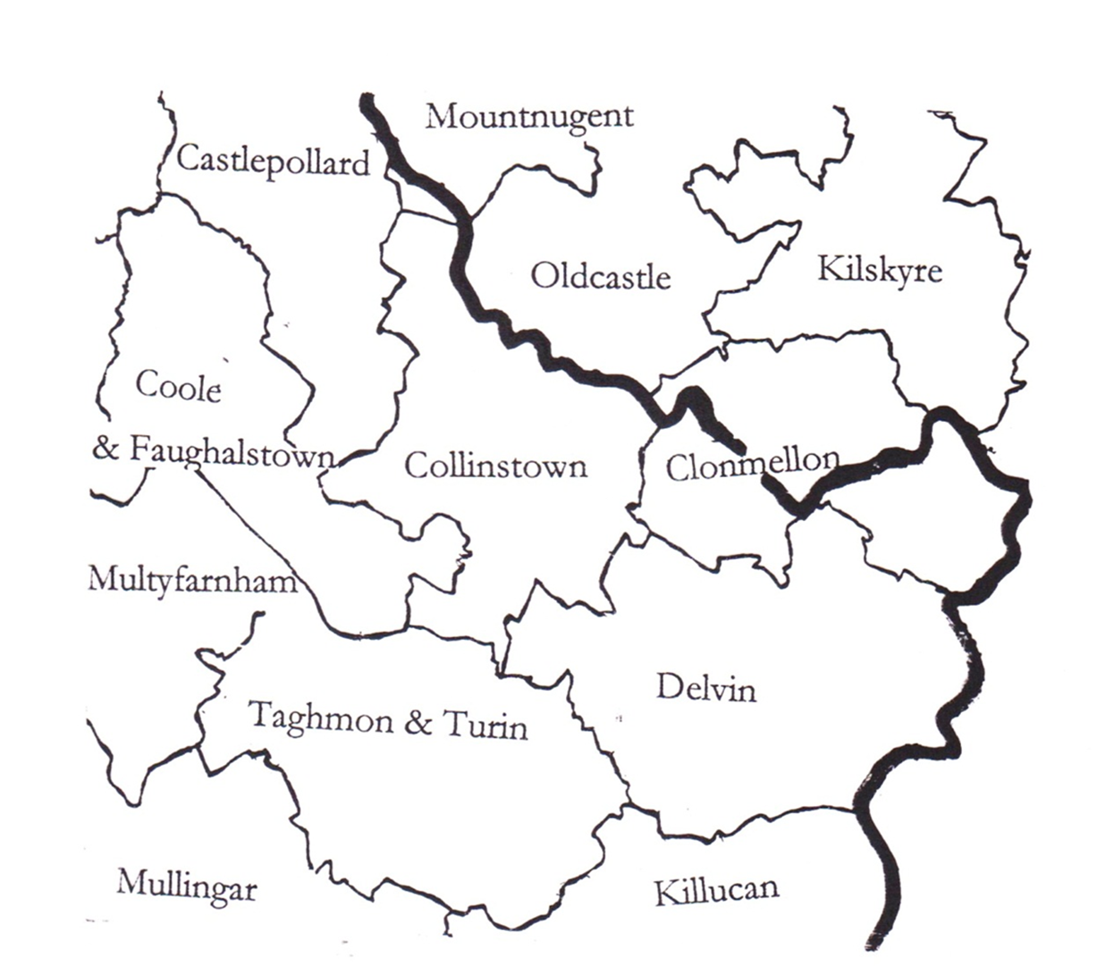
Roman Catholic Parish of Collinstown 1911 Census 2,258
1911 Census Parish of Collinstown
Occupation
Shepherds | 6
Blacksmiths Cooper | 10 1
Tailors | 3
Herds | 3
Dressmakers | 12
Milliner | 1
Sawyer | 1

Slide 29
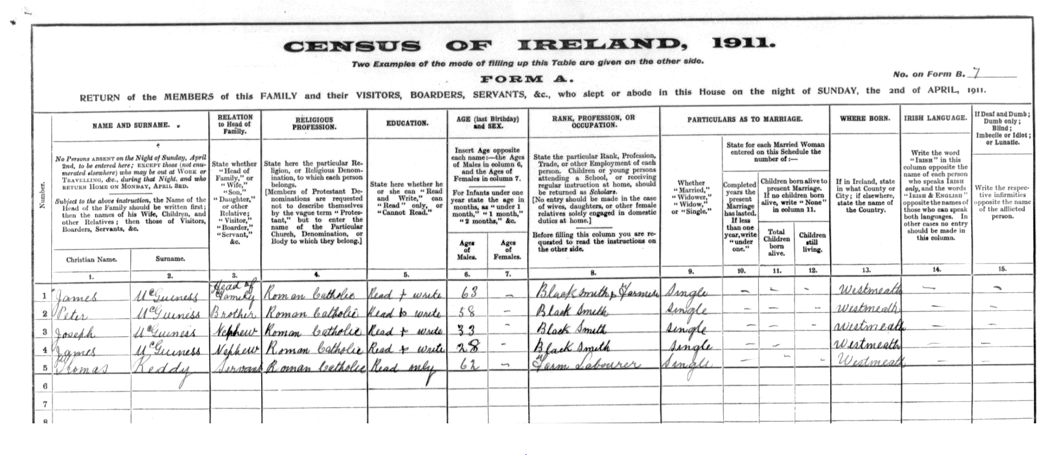

Slide 31
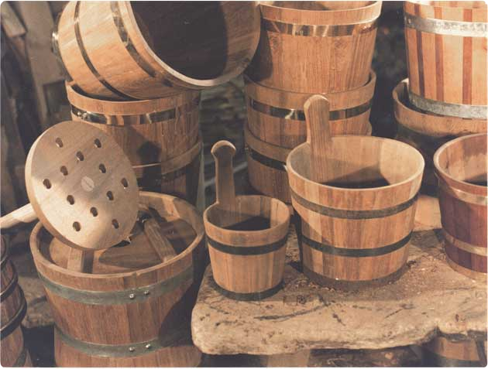
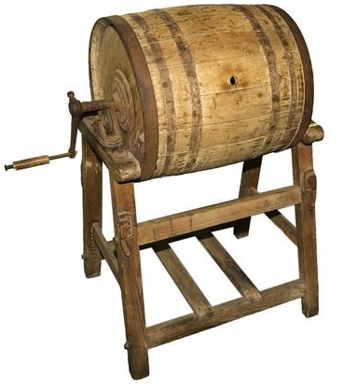
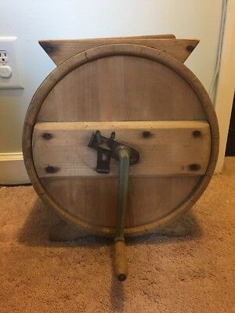
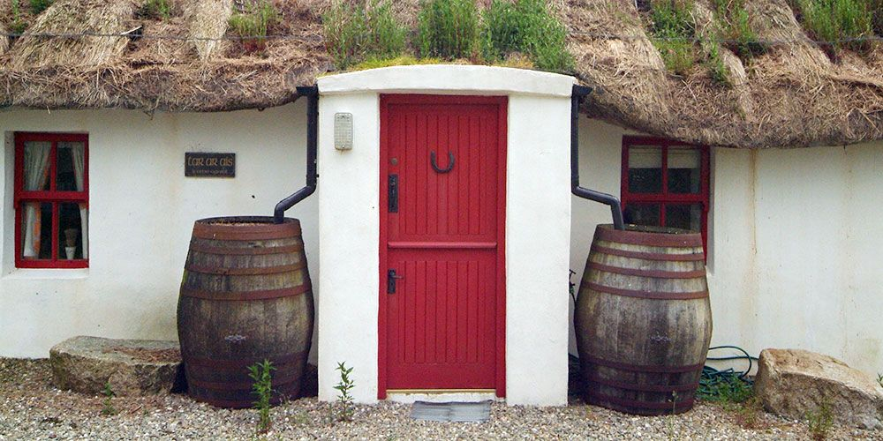

Slide 32
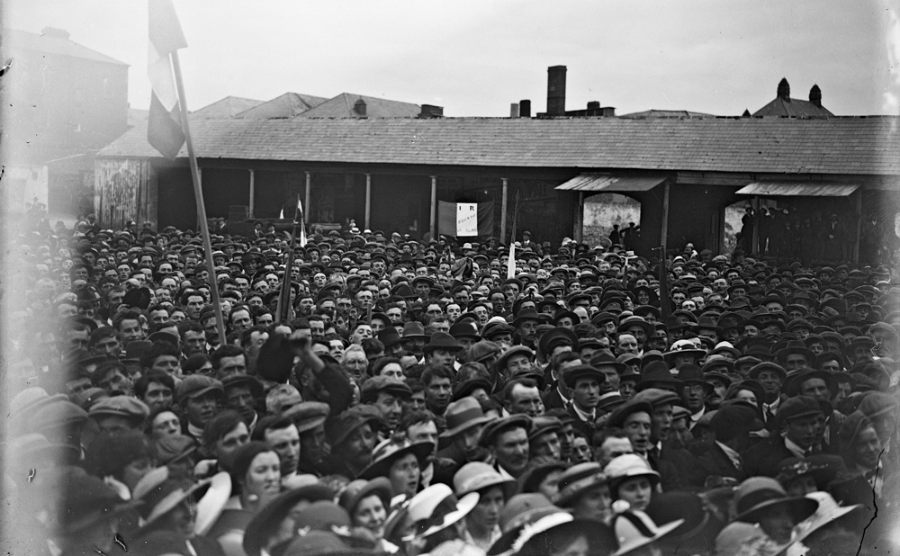

Slide 33
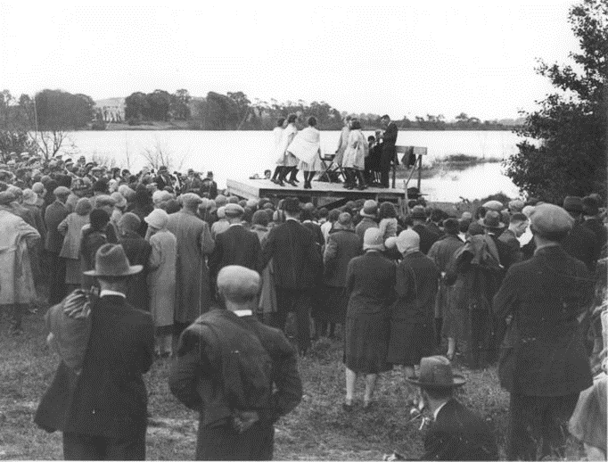
What brought people together?

Slide 34
Church

Slide 35
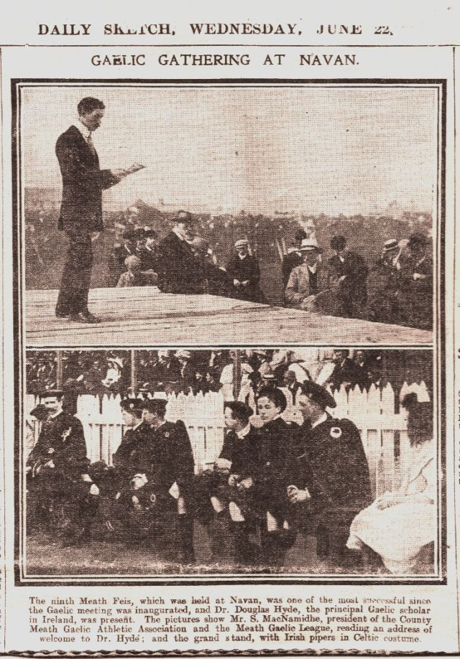
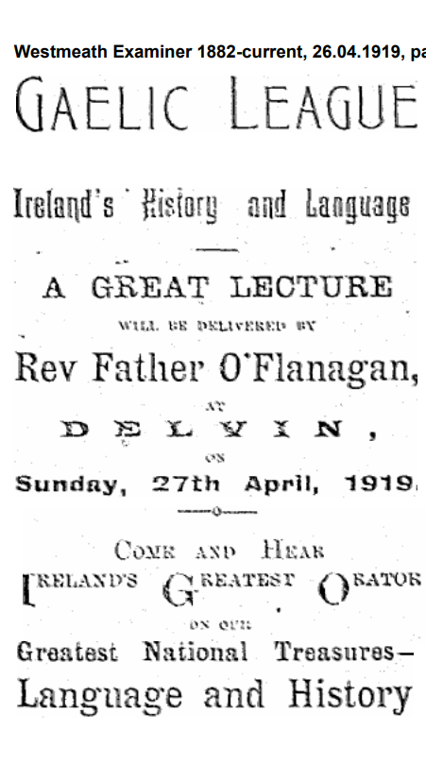

Slide 36
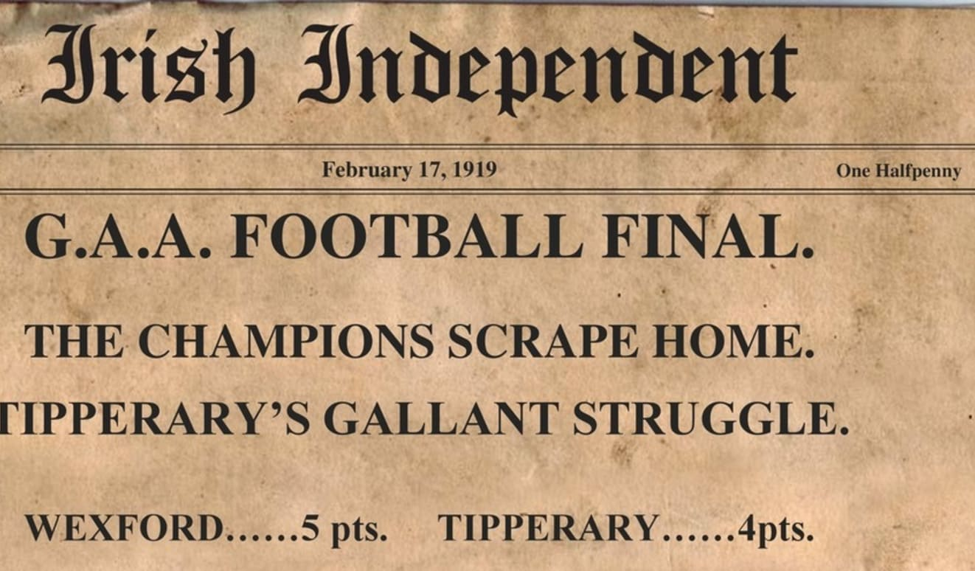
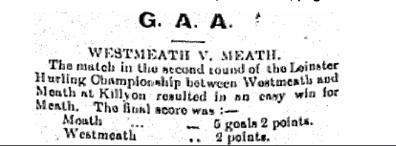
GAA
1918 All-Ireland Final which had to be postponed because of Spanish ‘Flu until the spring of 1919.
June 1919

Slide 37
Politics
1917

Slide 38
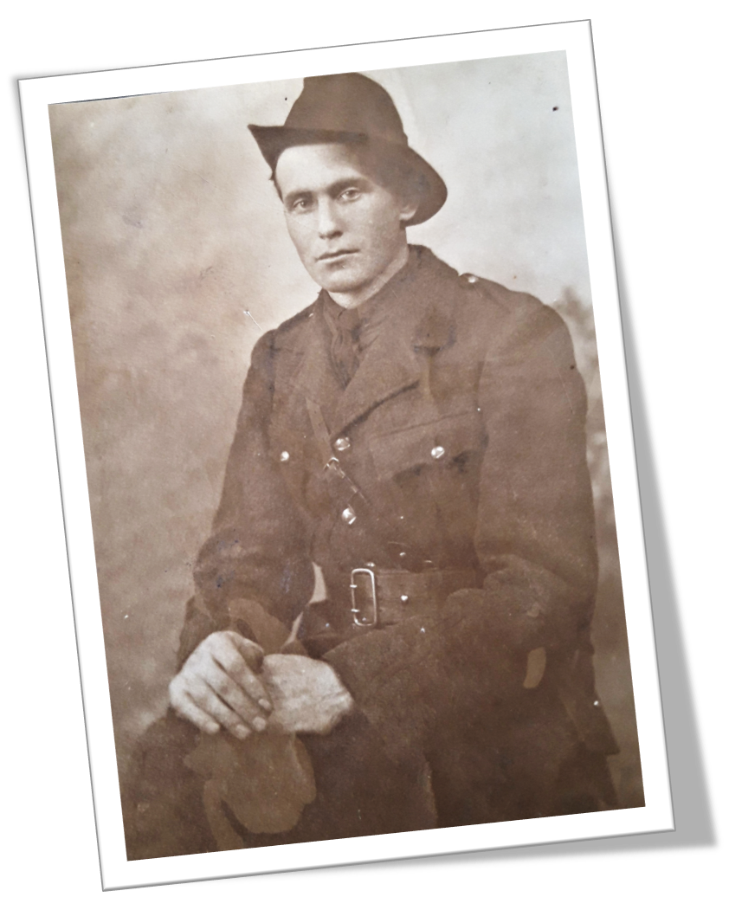
Volunteers
James Maguire

Slide 39
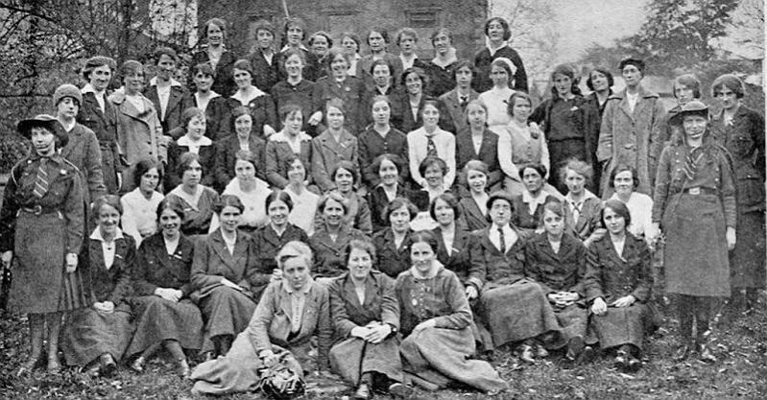
Cumann na mBan

Slide 40
aeraíocht
open-air entertainment

Slide 41
September 1913
Aeraíocht at Lough Lene
‘The beautiful lake never looked to better advantage than on Sunday.’

Slide 42
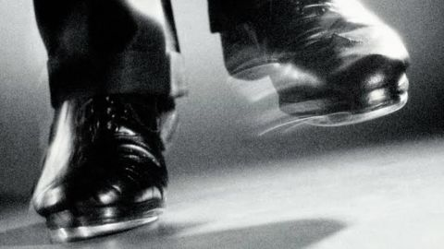
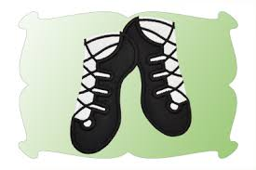
Owen Briody, Cummerstown Tom Lynch, Ankerland
IRISH SONG
IRISH DANCING
Miss Masterson, Collinstown
Miss O’Higgins from Kilskyre

Slide 43
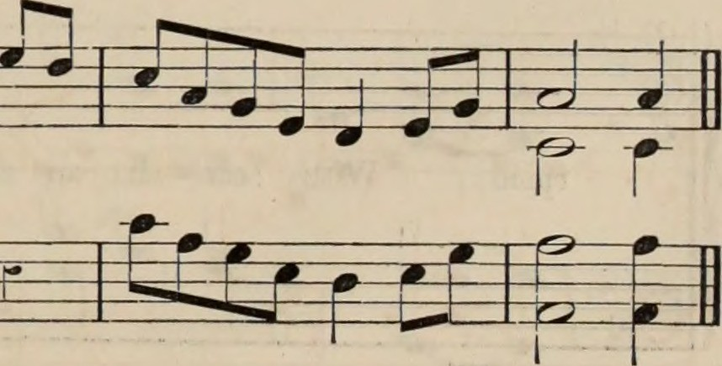
Irish Songs
Collinstown Choir
Glenidan School Choir
Fore School Choir

Slide 44
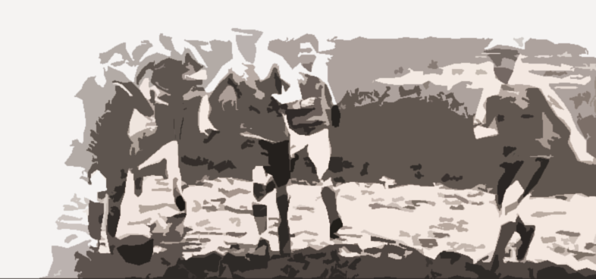
Gaelic Football Match
Collinstown v Athboy

Slide 45
E. Kent Irish Politics

Slide 46
Castlepollard
Witness Statements:
Patrick McCabe
John Macken

Slide 48
Francis Sheehy Skeffington

Slide 49
Hanna Sheehy Skeffington
Jack O’Sheehan

Slide 50
White Lake
Lough Glore

Slide 51
Activity
(ONE MORE SLIDE LEFT)

